Slide 1

A-Team Project “Taxi Service”

Slide 2
Team members
Roksolana Kril
Zamorylo Orest
Karaba Andriy
Komaniak Vitaliy
Krypiak Nazar

Slide 3


Target audience
Casual taxi users
Taxi companies

Slide 4
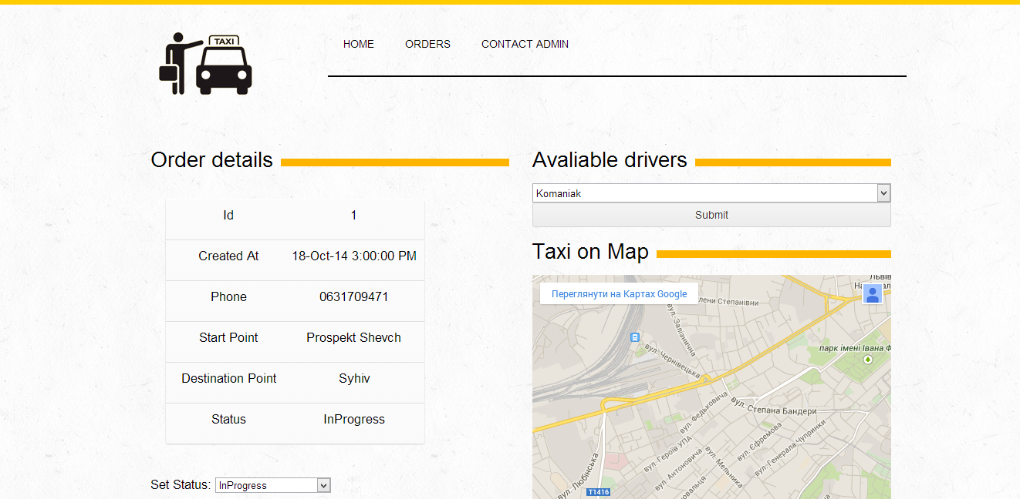
Admin Service Advantages
Simple order processing;

Slide 5
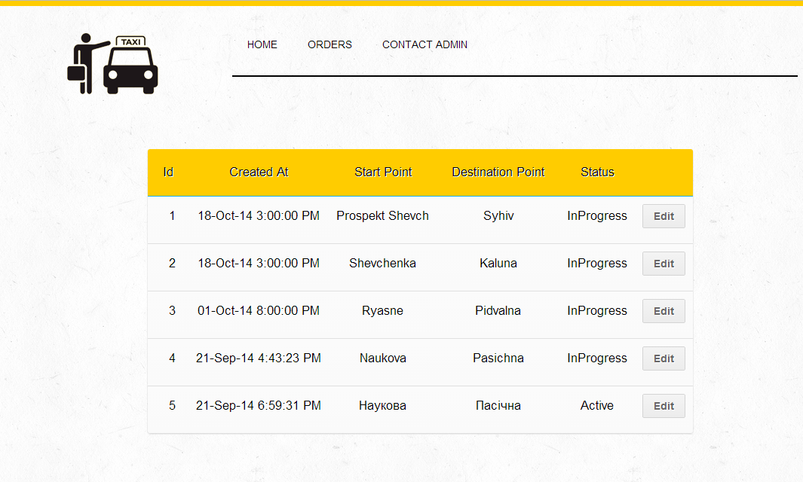
Admin Service Advantages
Simple orders control and track;

Slide 6

Admin Service Advantages
The best advertisement;

Slide 7
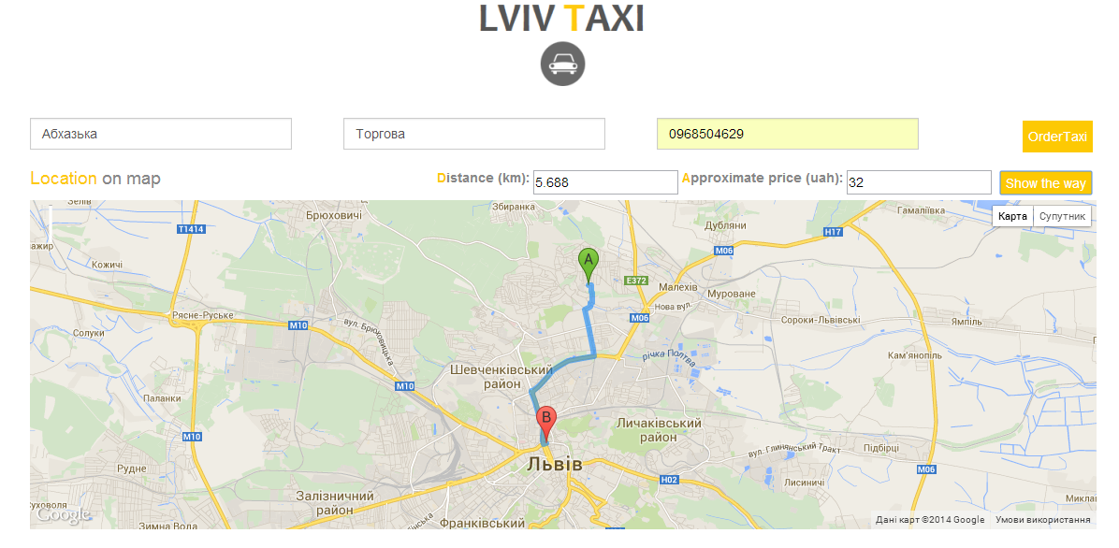
Ordering Section

Slide 8
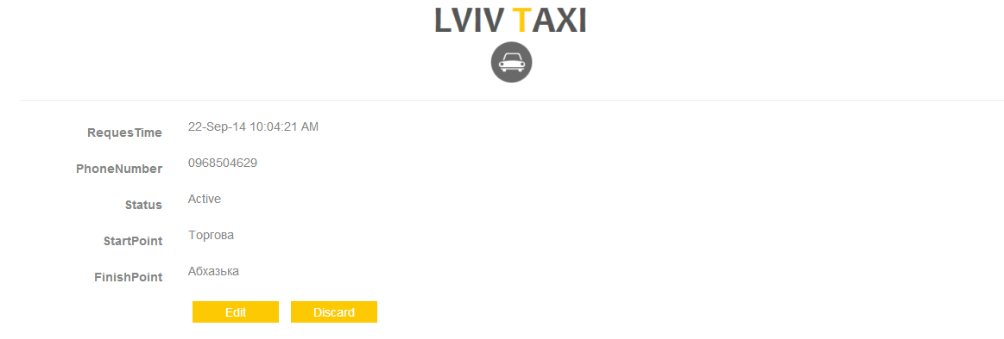
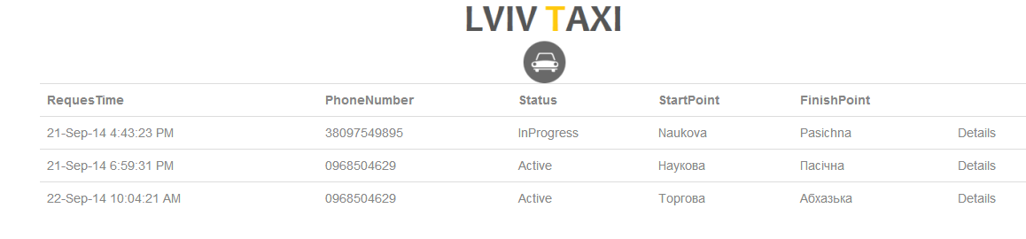
User request history and request edit

Slide 9
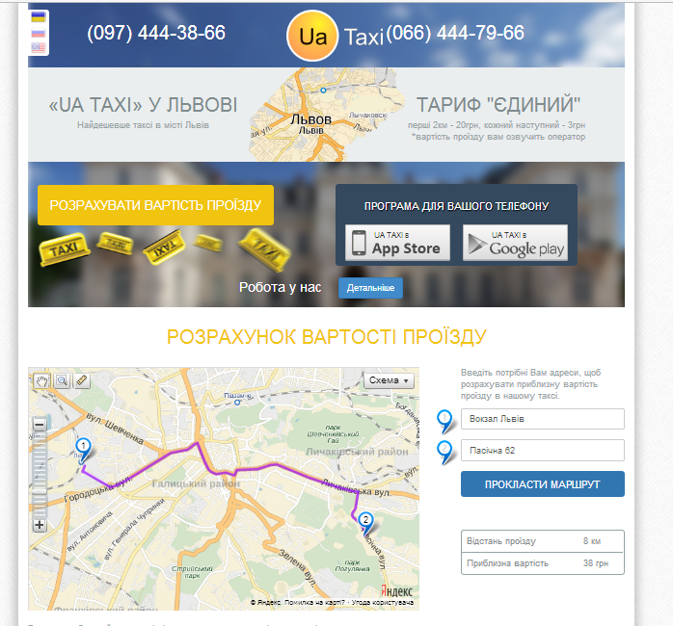

Existing solutions on the market
Lviv “UA TAXI” Service
Kyiv “Star - Taxi” Service

Slide 10





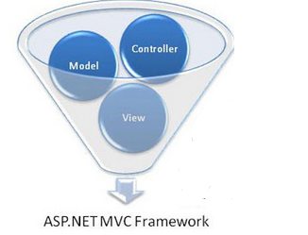
Technologies and Tools

Slide 11


